Slide 1
Workload Characterization Team
Leader: Pietro Cicotti - SDSC
Members:
Ilene Carpenter – NREL
Devesh Tiwari - ORNL
Chadha, Narjit - NetApp
Rick Mohr - UTK
Mike Booth – HPC Results
Ben Evans – Terascala

Slide 2
Workload Characterization
Goals
Understand and characterize workloads
Create a representative synthetic workload
Synergies
Kernel extraction/creation
Monitoring

Slide 3
Responses
centers:
ARSC
NCRC
NICS
OLCF
RIKEN
SDSC
storage:
P/S
FS
LTFS
D/H
D/C
W2/3
K
Oasis
600
TB
K
30
PB
FS
2.2
PB
W2
2.2
PB
FS:
360
TB
LTFS
2.2
PB
3.4
PB
W3
2.2
PB
Do
1.2
PB
Me
576
TB
Pu
576
TB
Mo
2.3
PB
apps:
WRF,PISM
mixed

Slide 4
Some stats
 | OLCF (widow2) | OLCF (widow3) | NCRC FS | NCRC LTFS | NICS (Kraken) | NICS (Medusa) | SDSC | ARSC | RIKEN
# users | ?? | ?? | ?? | ?? | 1650 | 1650 | 100+ | 345 | ??
server Version | 1.8.8 | 1.8.8 | 1.8.8 | 1.8.8 | 1.8.4 | 1.8.6 | 1.8.7 | 2.1.2 | ??
Client version | ?? | ?? | ?? | ?? | 1.8.4 | 1.8.6, 1.8.8 | 1.8.7 | >=1.8.6 | ??
# clients | 19042 | 19042 | 3908 | 40 | 9440 | 400 | 1638 | 500 | 88000
Interconnects (server-client) | DDR IB, Cray Gemini | DDR IB, Cray Gemini | QDR IB, Cray Gemini | QDR IB, Cray Gemini | Cray SeaStar | QDR IB | 10 GigE, IB, Myrinet | IB, Ethernet | IB, Tofu
size (raw) | 2.2 PB | 2.2 PB | 900 TB | 3.1 PB | 3.36 PB | 600 TB | 4608 TB | 360 TB | 10 PB (?)
# files | 107M | 117M | 65M | 38M | 256M | 18.3M | 141M | 7.1M | ??

Slide 5
File Size Distribution

Slide 6
File Capacity Distribution

Slide 7
Dir Size Distribution

Slide 8
Dir Capacity Distribution

Slide 9
Cumulative Distributions

Slide 10
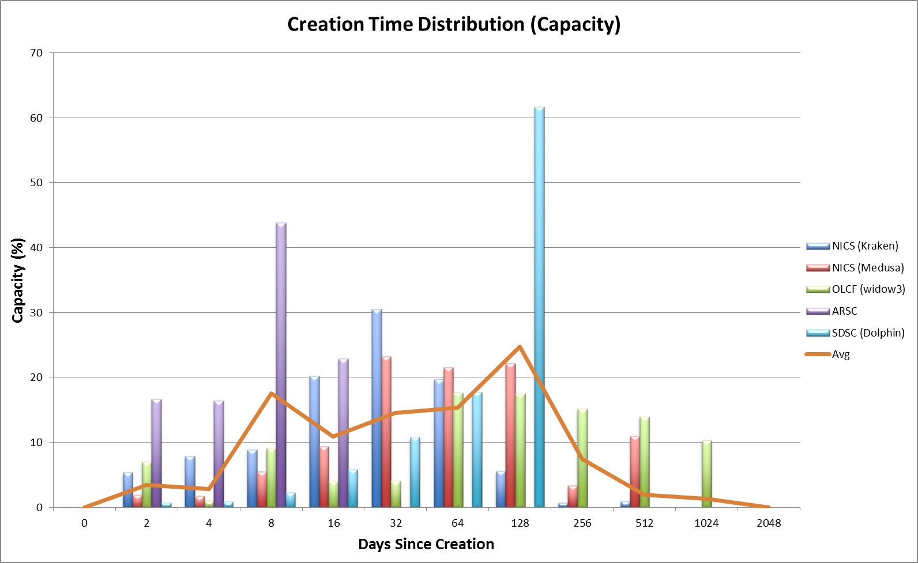
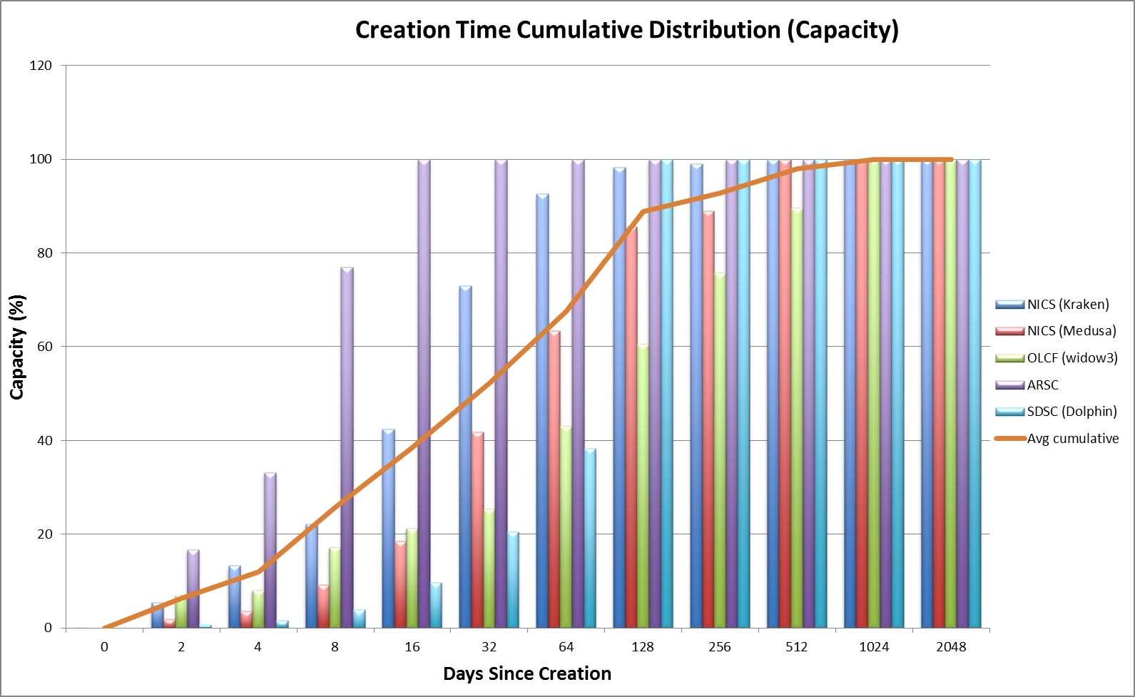
Creation Time Distribution

Slide 11
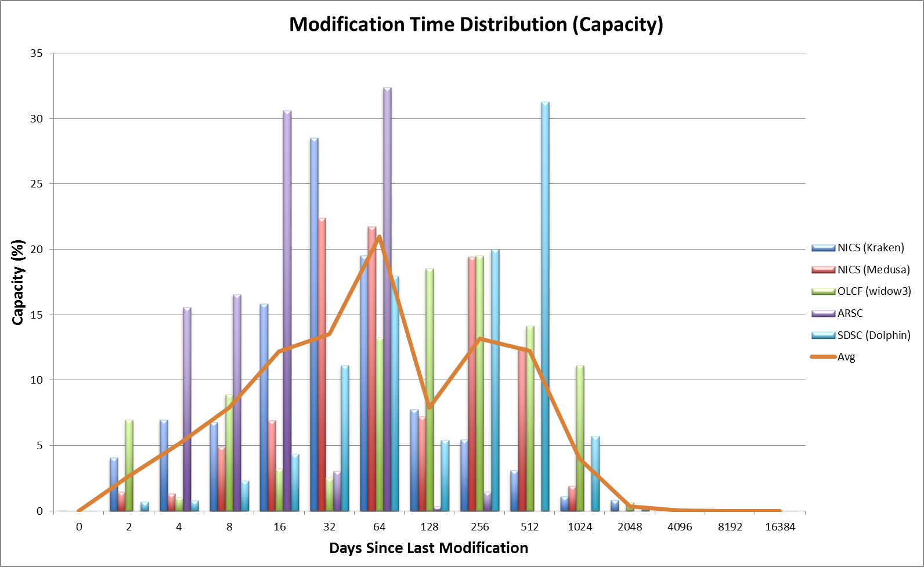
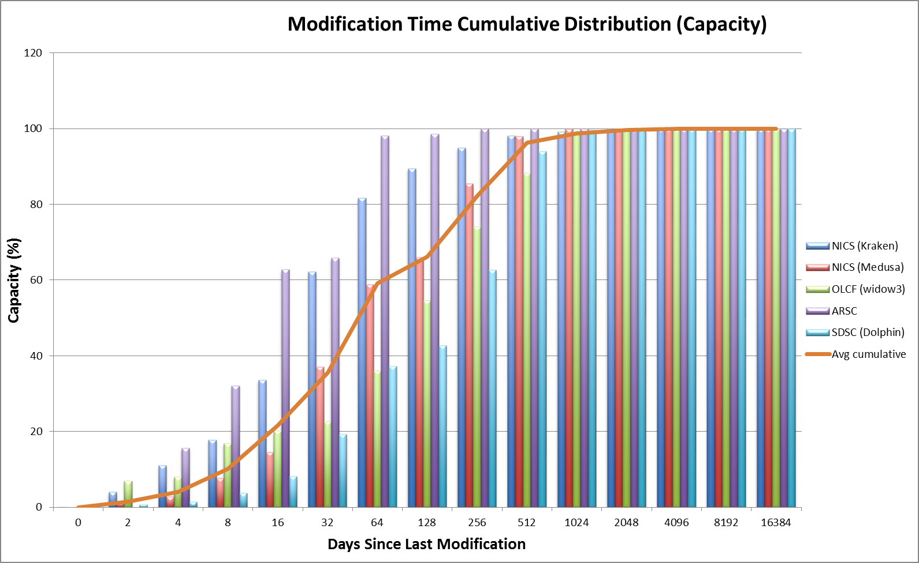
Modification Time Distribution

Slide 12
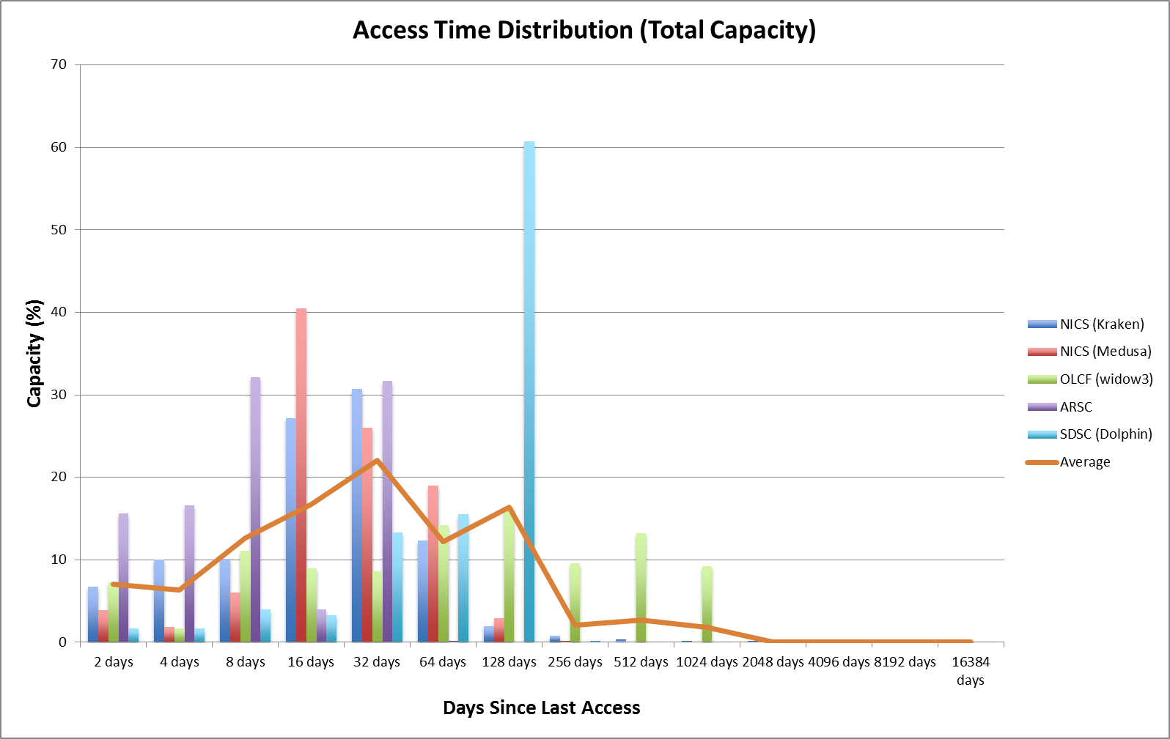
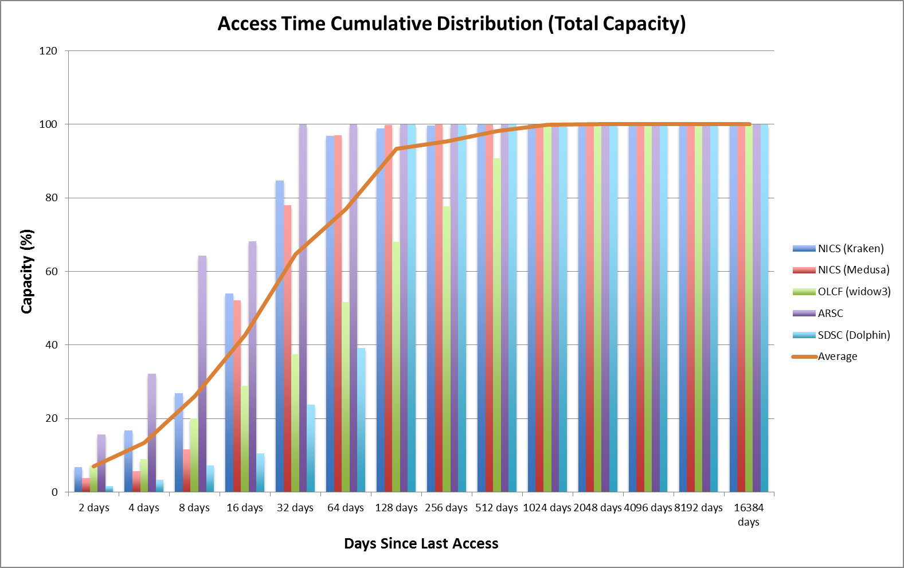
Access Time Distribution

