Slide 1
SPEC SFS 2014 An Under-the-Hood Review
Sorin Faibish
Spencer Shepler

Slide 2
SPEC SFS 2014 The Workloads and Metrics an Under-the-Hood Review
Historically, the SPEC SFS benchmark and its NFS and CIFS workloads have been the industry standard for peer reviewed, published, performance results for the NAS industry. The SPEC SFS framework has a strong history of reliable, reproducible results and the SPEC organization provides a structure to ensure that users have complete and comparable results.
The SPEC SFS 2014 benchmark generates file system workload through the use of operating system APIs instead of generating NFS or CIFS protocol messages directly as previous versions of SFS have done. The use of operating system APIs allows for measurement end-to-end and thus expands beyond the traditional NAS-only server measurement. For example the following can be measured and reported: local file systems, client-side file systems, network types (RDMA or non-RDMA), or client-side caching. This presentation will provide a review of the benchmark framework and its approach to generating workloads
This presentation will provide a review of the SPEC SFS 2014 workloads and a brief background of the development of each.
The attendee will leave with an understanding of the framework, its metrics and be ready to engage in measurement and product improvement.

Slide 3
Today’s Outline
Intro / Contributions / Motivation
SPEC SFS 2014 Framework
SPEC SFS 2014 Reporting
Workloads / Business Metrics
VDA
VDI
SWBUILD
Database
Notes:
Intro / Motivation (2-4 min)
SPECsfs 2014 Framework (15 min)
SPECsfs Reporting (5 min)
Workloads / Business Metrics
Includes unique validation criteria for each
VDA (6-7 minutes each)
VDI
SWBUILD
Database

Slide 4
Tonight’s BOF
Drinks and Snacks
Open discussion and additional detail…
Tonight 9:00 PM – 10:00 PM
Camino Real Room

Slide 5
SPEC Standard Performance Evaluation Corporation
The Standard Performance Evaluation Corporation (SPEC) is a non-profit corporation formed to establish, maintain and endorse a standardized set of relevant benchmarks that can be applied to the newest generation of high-performance computers. SPEC develops benchmark suites and also reviews and publishes submitted results from member organizations and other benchmark licensees
www.spec.org

Slide 6
Disclaimer
The SPEC SFS 2014 benchmark, as represented in this presentation, was released SW in November 4th 2014.

Slide 7
SPEC SFS 2014 Contributions
EMC | Tracing code, Validation, Testing, VDI Workload
Hitachi | Validation, Testing
Huawei | Validation, Testing
IBM | Reporting Tools, Validation, Testing, VDA Workload
Iozone.org | Source Code, Development, Testing, Validation, Binaries
Microsoft | Native Port to Windows, Validation, Testing, VDI Workload
NetApp | Validation, Testing, SWBUILD and DATABASE Workloads
Oracle | Validation, Testing, DATABASE Workload
Seagate | Validation, Testing

Slide 8
Motivation for SPEC SFS 2014

Slide 9
Motivation for SPEC SFS 2014
SPEC SFS 2014 moves to Solution Benchmarking
Realistic, Solution-based workloads
DATABASE, SWBUILD, VDA, VDI
Workloads based on traces, like previous SFS 2008
Modern scenarios based on standard solutions
Benchmark measures application-level performance
Uses file system APIs at the client
Advanced measurement – quality of service
Ops and latency don’t tell the whole story → business metrics
Ability to measure broad range of products and configurations
Clients, Servers, Local File Systems, Networking Transports
All of these now contribute to measured performance of solution
Allowing for multi-tiered storage solutions
Notes:
Move away from System Benchmarking
All previous versions of the SFS workloads represent direct protocol generation (NFSv2, NFSv3, CIFS)
Only measures the file server and has been limited to a single, narrow workload
Difficult to update benchmark and workloads
No measurement of the “client” or local file systems
Unable to adapt to industry changes

Slide 10
SPEC SFS 2014 Framework

Slide 11
SPEC SFS 2014 Framework
Two components:
Load generator: netmist
Highly customizable, powerful, workload generator
SPEC SFS 2014 license includes full version
Wrappers: SfsManager
Provides ease of configuration
Coordinates running multiple load points (scaling)
Implements business metric logic
Framework features:
Multi-client support is fundamental
Supports many operating systems and virtual machines
Protocol/file system agnostic
Definable workloads
Full source code included with SPEC SFS 2014 benchmark

Slide 12
SPEC SFS 2014 Framework
Benchmark execution phases
Validation
Initialization
Warmup
Measurement (Run)
Results
This sequence of execution phases repeats for each requested load point

Slide 13
SPEC SFS 2014 Reporting

Slide 14
SPEC SFS 2014 Reporting Publication of Results
Prior to public disclosure, SPEC SFS 2014 results must be submitted for review by the SPEC SFS subcommittee
Results are peer-reviewed for consistency and compliance with the SPEC SFS 2014 Run and Reporting Rules
Disclosure must be adequate for reproducibility
Accepted results are then published to the SPEC website
Results can be released publicly without prior committee review – however, if asked, full disclosure must be provided to SPEC

Slide 15
SPEC SFS 2014 Reporting Run and Reporting Rules
The SPEC SFS 2014 Run and Reporting Rules bound the measurement and configuration methodology
Primary goal of rules is to support SPEC’s philosophy of fair and open benchmarking
Secondary goal is to ensure sufficient disclosure for reproducibility and comparability

Slide 16
SPEC SFS 2014 Reporting Run and Reporting Rules Highlights
There is no Uniform Access Rule
The WARMUP time may be set to between 5 minutes and 1 week for a publishable run
There is no requirement to reinitialize file systems before a publishable run
However, detailed documentation of actions taken since system (re)initialization is required
Single publication covers 1 workload
No requirement that all or more than one be reported at the same time

Slide 17
SPEC SFS 2014 Reporting No “newfs” Requirement
Re-initializing the storage under the file system may not be possible or realistic
Cloud storage, complex tiered storage
More than one file system in the storage hierarchy
Must document procedures and steps taken since last re-initialization
Must be generally available and recommended for customers – no “benchmark specials”
Documentation/review allows for reproducibility
Can be used to simulate “aged” systems
Especially in conjunction with long WARMUP

Slide 18
SPEC SFS 2014 Defining a Workload

Slide 19
Workloads and Business Metrics Workload Definition
Workloads are richly defined in SPEC SFS 2014
Separate I/O size distributions for reads/writes
Each has 16 buckets; each bucket can be a range
Min I/O size: 1 byte; Max I/O size: size_t
22 file operations available to define workload
“Data”
Read/write ops: sequential, random, whole file, memory mapped
Read-modify-write, copyfile, append
“Metadata”
POSIX file ops: mkdir, stat, rename, chmod, etc.

Slide 20
Workloads and Business Metrics Workload Definition
Three parameters to control write behavior
% Write commits, % O_DIRECT, % O_SYNC
The method used for direct io is OS dependent.
Other parameters to change workload and dataset behavior, such as
% Geometric – certain files will be accessed more
% Compress – compressibility of the dataset
The dataset produced by SPEC SFS 2014 is not designed to be dedupable

Slide 21
Workloads and Business Metrics Business Metric Definition
A business metric is a unit of workload, made of:
One or more component workloads
Execution parameters
Success criteria (thresholds)
Why business metrics?
Simulating real-world workloads
Reporting results in real-world language
Success criteria attach more meaning to results than just a load level: quality

Slide 22
Workloads and Business Metrics Business Metric Scaling
The definition of a single business metric is fixed
Discrete and independent units of workload
Load scaling is achieved by adding additional business metrics
As load increases, so does
Proc count
Dataset size
The oprate of each proc is constant, however!

Slide 23
Workloads and Business Metrics Business Metric Success Criteria
Business metric success criteria (thresholds)
Global oprate threshold monitors the average oprate of all procs
Proc oprate threshold monitors the oprate of all procs
Any single proc exceeding the threshold invalidates that load point
Achieved oprate must be >= x% of defined

Slide 24
Workloads and Business Metrics Business Metric Success Criteria
Business metric success criteria (thresholds)
Workload variance threshold monitors ratio of global achieved oprates between all component workloads
This ratio must be within +/- x%, as defined in the threshold
Example: DATABASE has a 5:1 oprate ratio between the DB_TABLE and DB_LOG component workloads
Ratio of achieved oprates must be within +/- 5% of 5:1

Slide 25
Workloads and Business Metrics Business Metric Success Criteria
Business metric success criteria (thresholds)
With these success criteria, a business metric demands a certain quality of service at all load points
If a success criteria is not met for a requested load point, that point is marked INVALID
An INVALID data point does not stop the benchmark run, but is not publishable

Slide 26
Workloads and Business Metrics Benchmark Results
There are two principal measures of performance in SPEC SFS 2014
Business Metrics
Overall Response Time
Achieved Oprate and Total KBps will be included in official publications as well
The sfssum file produced during a benchmark run contains all this info and more

Slide 27
Workloads and Business Metrics Benchmark Results
Disclosure of results must include the summary result
Maximum achieved business metrics and overall response time of the entire benchmark run
Specific format in Run and Reporting Rules
The full disclosure report is published on the SPEC website
Visual: Business Metrics vs. Response Time
Notes:
Overall Response Time is calculated only when generating the Full Disclosure Report.

Slide 28
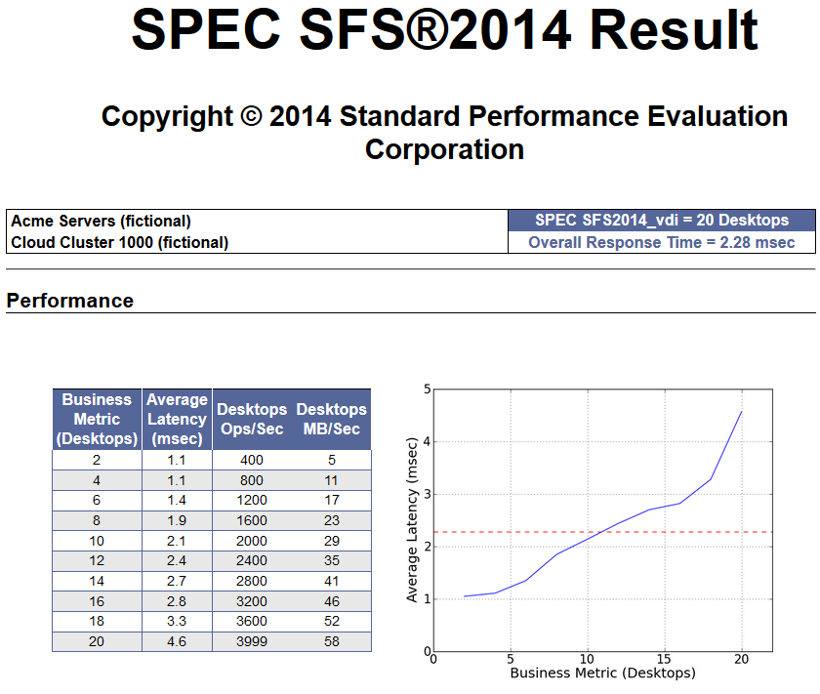
Workloads and Business Metrics Benchmark Results

Slide 29
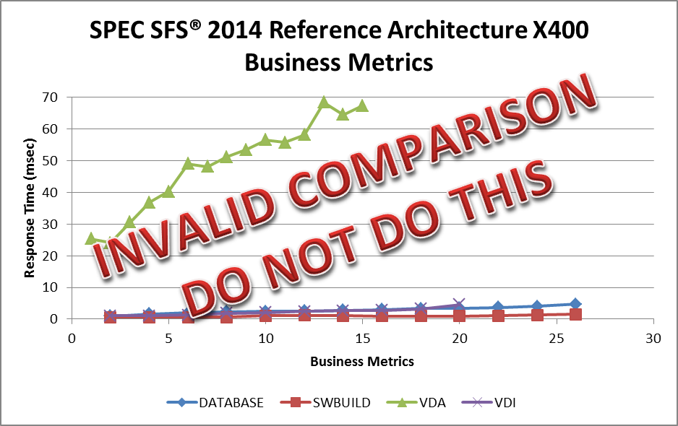
Workloads and Business Metrics Benchmark Results

Slide 30
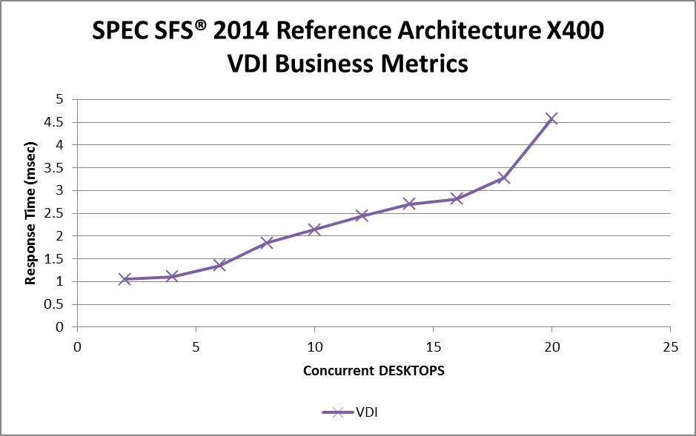
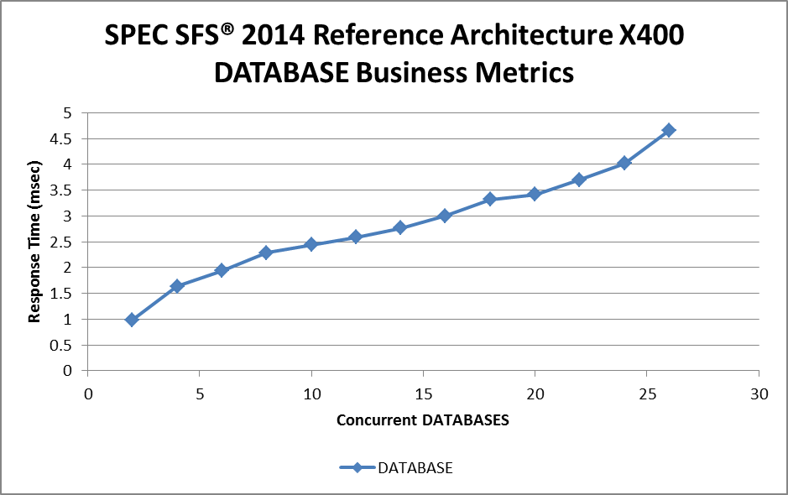
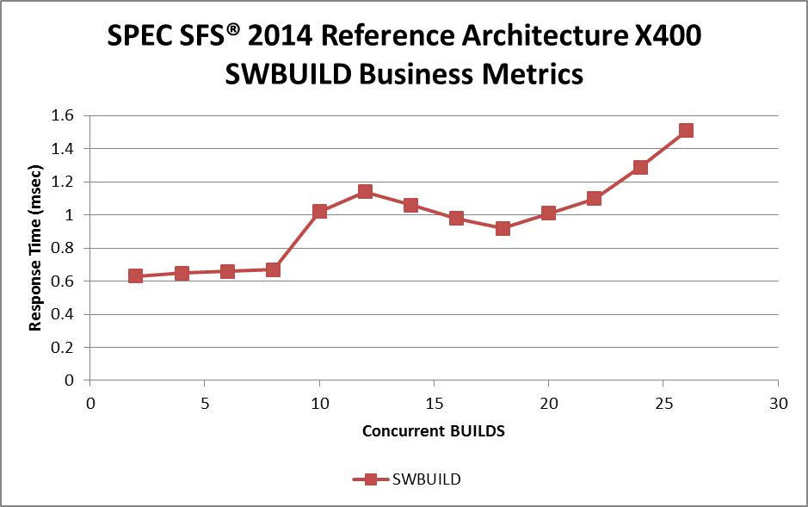
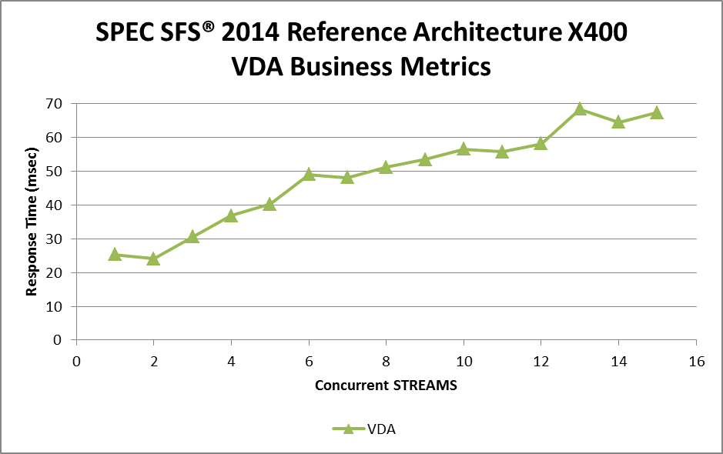
Workloads and Business Metrics Benchmark Results

Slide 31
Workloads and Business Metrics Overall Response Time
Overall response time is calculated differently in SPEC SFS 2014
Still the area under the curve divided by the maximum achieved business metric
Origin point (0,0) is no longer assumed
First point used in the calculation is the first achieved result
No longer seems appropriate to assume the curve will be a certain shape

Slide 32
SPEC SFS 2014 Workloads

Slide 33
SPEC SFS 2014 Workloads Video Data Acquisition (VDA)
Simulates acquisition of data from a temporally volatile source (surveillance, big data ingest)
Metric: Concurrent STREAMS
Workload derived from IBM Redbooks
Two component workloads, 9:1 oprate ratio
VDA1, data stream
~36 Mb/sec sequential writes (upper range of HD video)
VDA2, companion applications/user access
89% read, 2% read-modify-write, 9% metadata

Slide 34
SPEC SFS 2014 Workloads Video Data Acquisition (VDA)
VDA2 workload ensures that quality of data ingestion is maintained despite other activity
Starvation of reads or writes will be detected by success criteria violation
Per-proc oprate: >= 75% of requested
Overall oprate: >= 95% of requested
Component workload variance: <= 5% of defined

Slide 35
SPEC SFS 2014 Workloads Virtual Desktop Infrastructure (VDI)
Simulates the workload generated by a hypervisor to support a heavy steady-state knowledge worker workload
Workload derived from traces of ESXi, Hyper-V, and Xen environments
Metric: concurrent DESKTOPS
One component workload, 2 procs per desktop
Data-heavy workload: 1% metadata ops

Slide 36
SPEC SFS 2014 Workloads Virtual Desktop Infrastructure (VDI)
Simulates steady-state VDI workload
Does not include boot storm or login storm
All writes use Direct I/O
Dataset consists of compressible (60%) large files (500MB)
Dataset is not dedupable – simulates a VDI scenario using Full Clones

Slide 37
SPEC SFS 2014 Workloads Software Build (SWBUILD)
Simulates large software project compilation or build phase of an EDA workflow
Workload derived from traces taken during software build activity and ClearCase documentation
Metric: concurrent BUILDS
One component workload, 5 procs per build
Metadata-heavy: 87% metadata ops

Slide 38
SPEC SFS 2014 Workloads Software Build (SWBUILD)
Reads and writes are done on a whole file
Average file size is a Gaussian distribution centered at 16 KiB, ~573,000 files per build
Files are highly compressible (80%)
This workload has the most potential to be cached/modified by the load generating clients
Also most likely to introduce/measure a bottleneck on load generating clients vs. storage solution

Slide 39
SPEC SFS 2014 Workloads DATABASE
Simulates an OLTP database consolidation scenario
Workload derived from data from Oracle
Metric: concurrent DATABASES
Two component workloads, 5:1 oprate ratio
DB_TABLE
Random reads and writes
DB_LOG
Mostly sequential writes

Slide 40
SPEC SFS 2014 Workloads DATABASE
All DB_TABLE threads for an individual business metric share the same dataset
Multiple threads working the same tables
Workload simulates moving hot spots in the dataset
These hot spots move over time
Solution under test must provide good quality of service to both table and log I/O
Maximum component workload variance is <= 5%

Slide 41
SPEC SFS 2014 Read Size Distribution

Slide 42
SPEC SFS 2014 Write Size Distribution

Slide 43
SPEC SFS 2014 Workloads Summary
SPEC SFS 2014 Workloads are richly-defined, realistic, solution-based workloads
Results are measured in Business Metrics
Real-world language for real-world workloads
Quality of service is measured with success criteria
Performance is measured at the application level
Performance of whole solution is measured
Modern scenarios based on standard solutions
Workload definitions and source available to all SPEC SFS 2014 licensees
Open, transparent, and fair benchmarking

Slide 44
Future Investigations
More Workloads
Windows Homefolders (a.k.a. FSCT)
HPC
Movie Production
Video Distribution
Support More Storage APIs
Block Device
MPI-IO
HDFS
CDMI
Energy Efficiency
Work with SNIA and the EPA. Energy Star standard
Power Measurement
Source code continues to be provided for everything as SPEC maintains openness and transparency

